Slide 1
95885 Project 1
Study on the effect of the minimum wage
Pang-Cheng Liu, Xi Yan

Slide 2
Key Findings
1. Although the nominal minimum wage increases throughout decades, the real minimum wage does not increase from 1968 to 2020.
2. Democratic states generally have higher minimum wage than Republican states.
3. Since the minimum wage on Republican States barely increases from 1970 to 2020, considering the inflation, the minimum wage workers earn less now than 1970 in Republican states.
4. The movement of labor productivity in individual state follows the minimum wage, which indicates a positive correlation between these two measures.
5. It is difficult to find the correlation between unemployment rate and the real minimum wage due to volatility of unemployment rate.

Slide 3
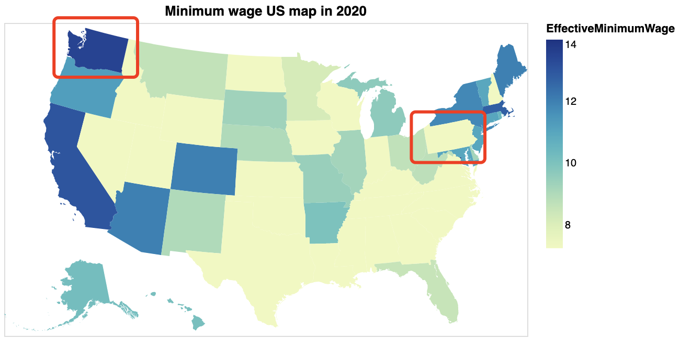

Motivation
Dish washer in Washington states ($16/hour) > Graduate Teaching Assistant in Pennsylvania ($15/hour)
Minimum wages are different between states.
Does increasing minimum wage beneficial to individual and society?

Slide 4
Data Source
Primary source: US Minimum Wage data
Kaggle: https://www.kaggle.com/lislejoem/us-minimum-wage-by-state-from-1968-to-2017
State Labor Productivity data
US Bureau of Labor Statistics: https://www.bls.gov/lpc/state-productivity.htm
State Unemployment data
US Bureau of Labor Statistics: https://www.bls.gov/charts/state-employment-and-unemployment/state-unemployment-rates-animated.htm
State Party Affiliation data
https://en.wikipedia.org/wiki/Red_states_and_blue_states

Slide 5
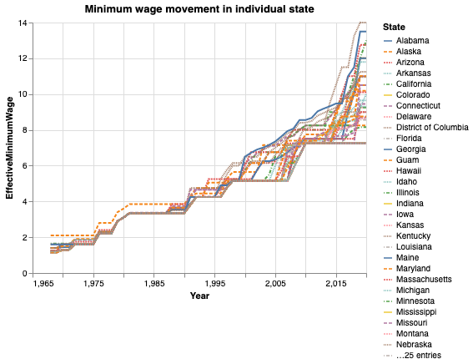
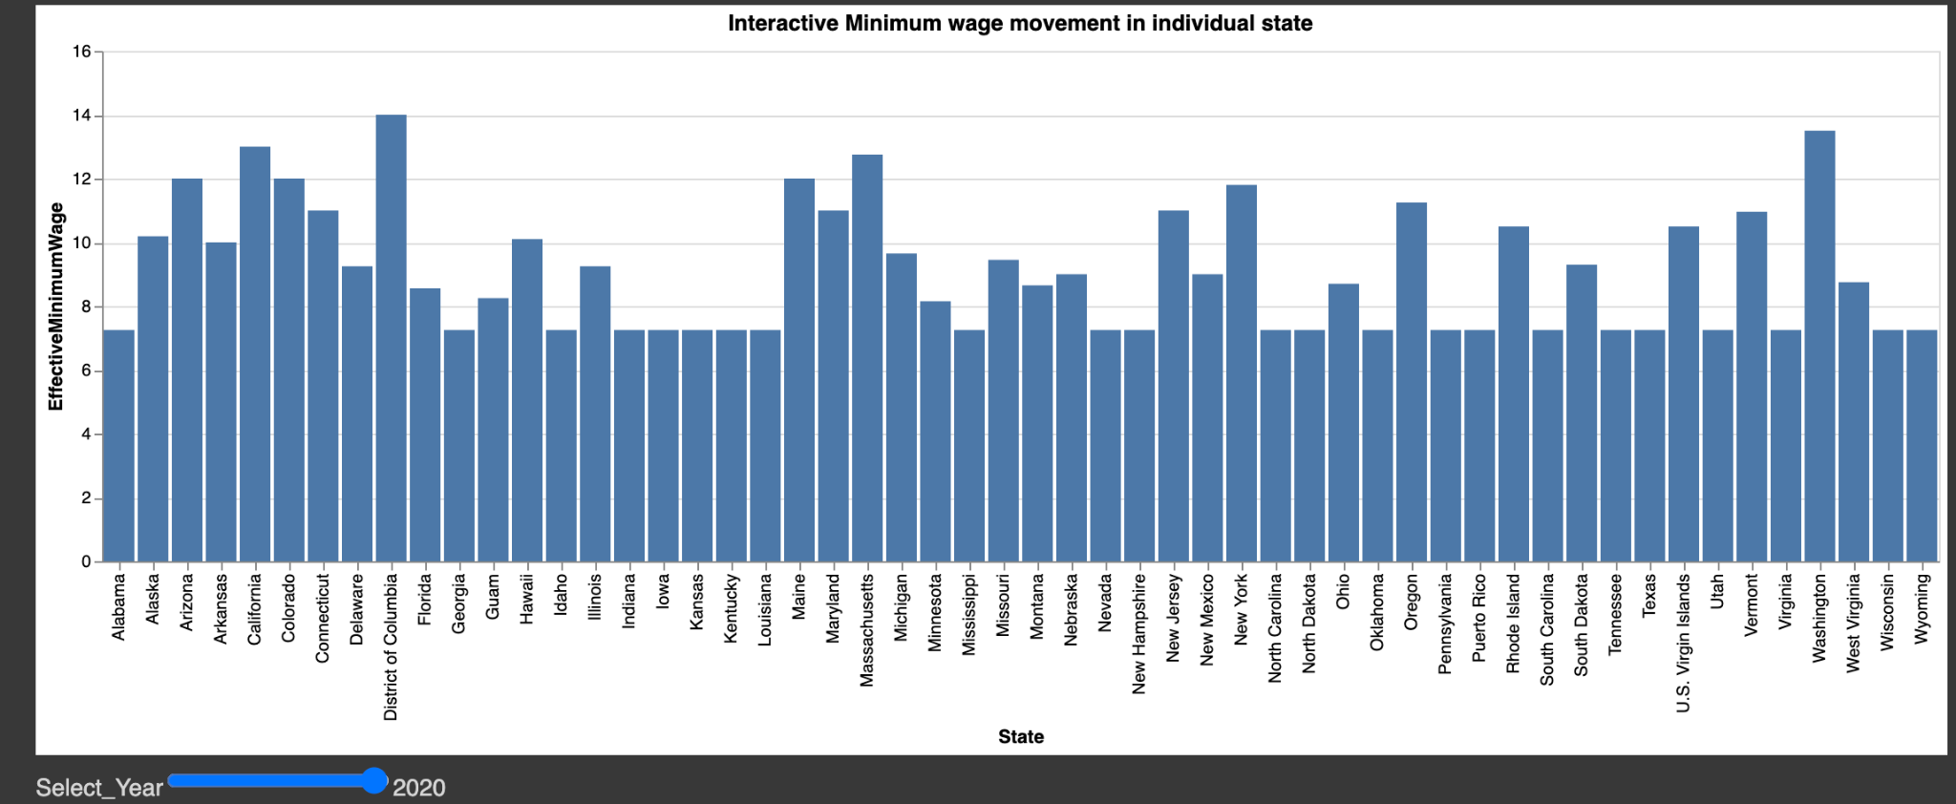
Exploratory Analysis

Slide 6
Objectives
The movement of Minimum Wage throughout history, by national and by individual state.
The real change of minimum wage excluding inflation
Minimum wage with party affiliation
Real minimum wage and labor productivity in individual state
Real minimum wage and unemployment in individual states

Slide 7
Objective 1: The movement of Minimum Wage throughout history, by national and by individual state.

Slide 8
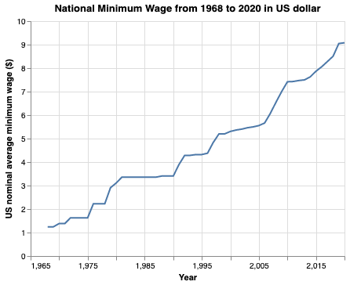
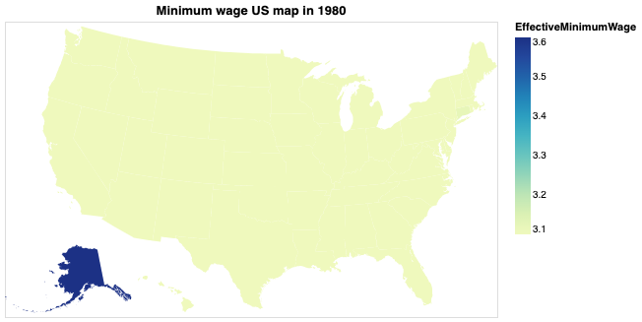
The movement of Minimum Wage throughout history
1980
Increasing Trend
Equally low across states

Slide 9
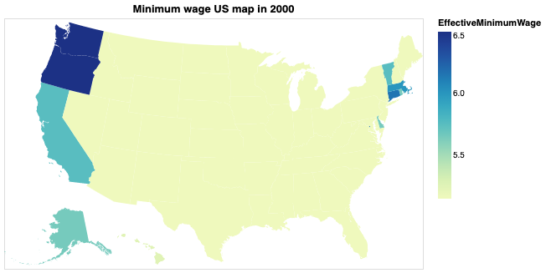
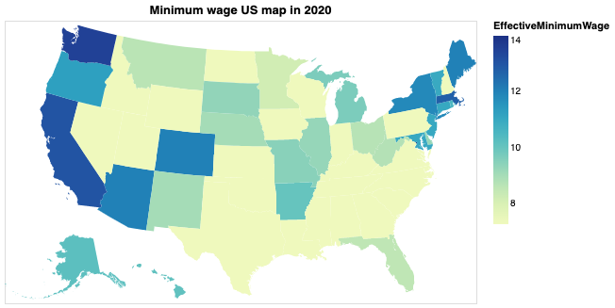
The movement of Minimum Wage throughout history
2000
2020

Slide 10
Objective 2: The real change of minimum wage excluding inflation.

Slide 11
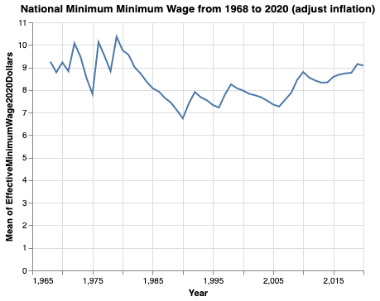
The real change of minimum wage excluding inflation.
Increasing Trend
Roughly the same
Notes:
If we just look at the "National Minimum Wage" graph, we might think the US minimum wage increases overtime. However, if we look at the "Minimum Wage in 2020 dollars" graph, the average minimum wage actually did not change much. The Effective Minimum Wage takes in to account of inflation. If we convert everything to 2020 US dollar values. The real minimum wage does not increase over the years.

Slide 12
Objective 3: Minimum wage with party affiliation

Slide 13
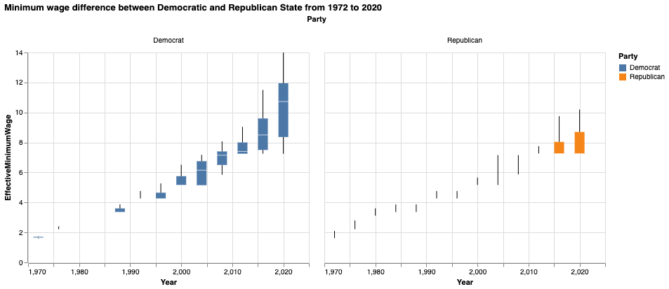
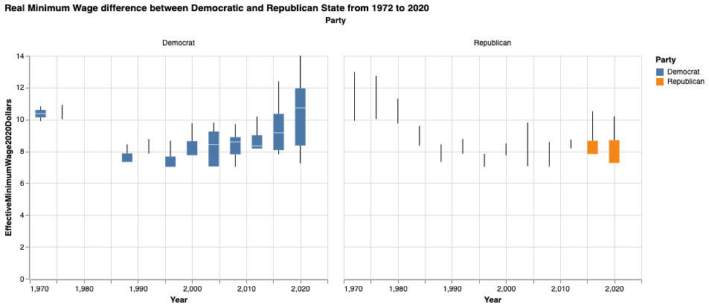
Minimum wage with party affiliation
Minimum Wage Including Inflation
Minimum Wage Excluding Inflation

Slide 14
Objective 4: Real minimum wage and labor productivity in individual state.

Slide 15
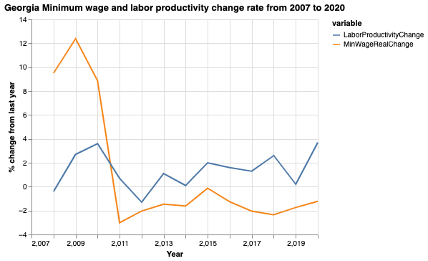
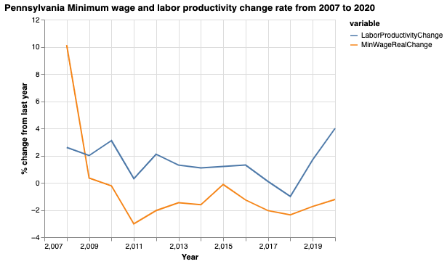
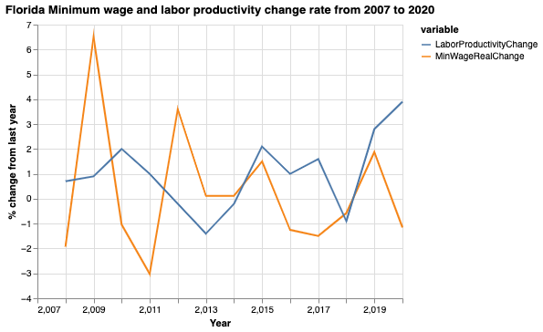
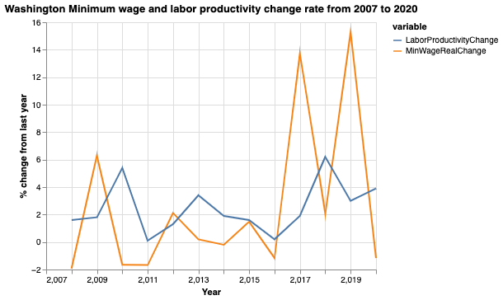
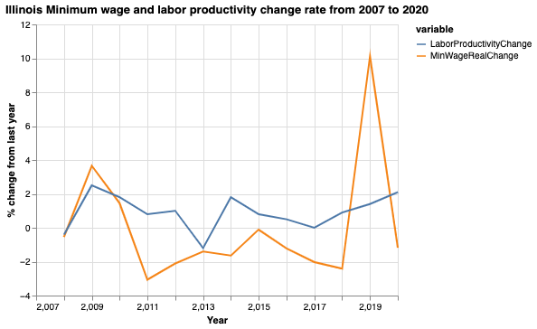
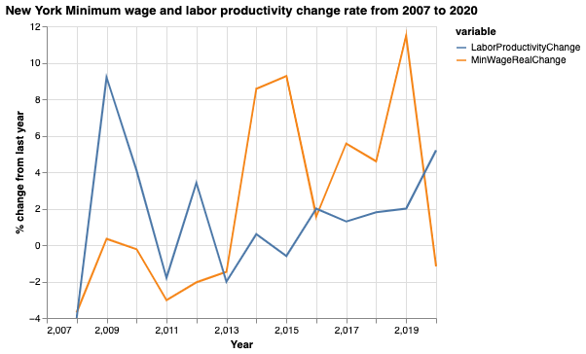
Minimum Wage v.s. Labor Productivity

Slide 16
Objective 5: Real minimum wage and unemployment in individual states.

Slide 17
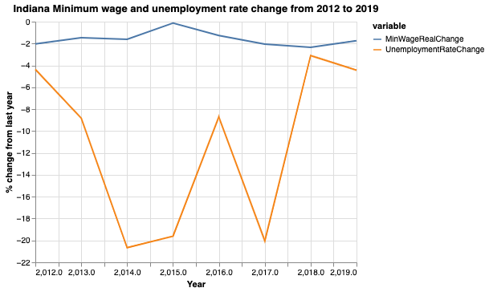
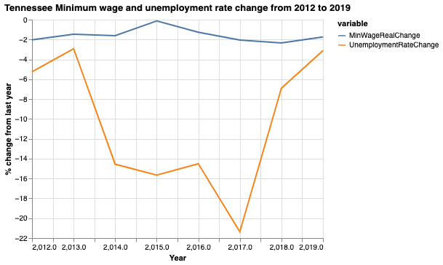
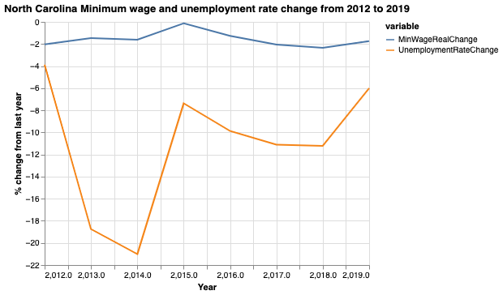
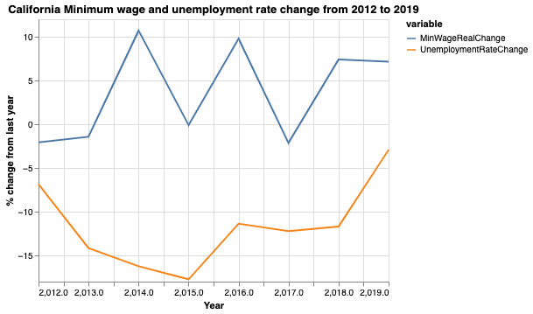
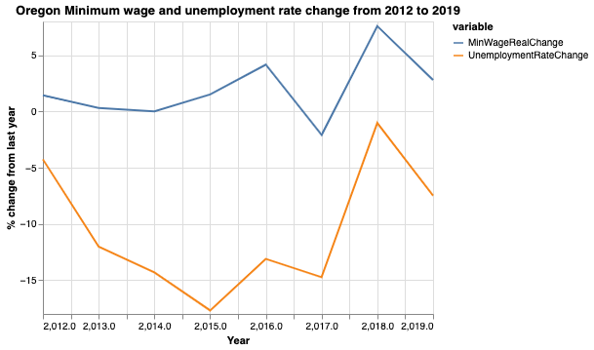
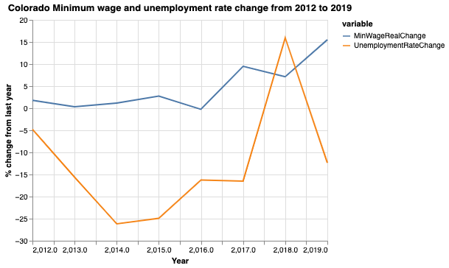
Minimum Wage v.s. Unemployment
Notes:
Looking at these 6 states, the movement of unemployment rate change seems uncorrelated to the real minimum wage change. The unemployment rate change is more volatile than the minimum wage real change, but generally the unemployment rate steadily decreases from 2012 to 2019.
Considering that unemployment rate is closely related to the economy, we are not able to find more insight about the correlation between unemployment and minimum wage without further modeling and analysis.

Slide 18
Future Work
Further conduct study for labor productivity and minimum wage by filtering the labor productivity on low-income households and individuals.
Further conduct study for unemployment rate and minimum wage by excluding the effect of economy, such as GDP.
Conduct study on whether state level or national level GDP is impacted by raising the minimum wage.
Use Machine Learning models, such as regression, to predict the minimum wage for each state in the future using features of labor productivity, party affiliation, and unemployment rate.

